Slide 1
Soil Properties

Slide 2
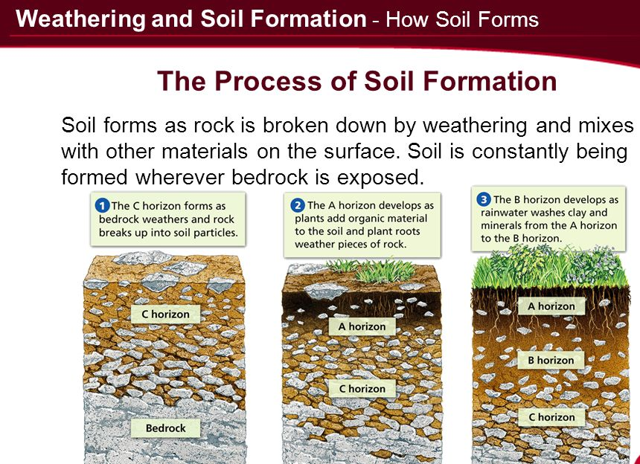

Slide 3
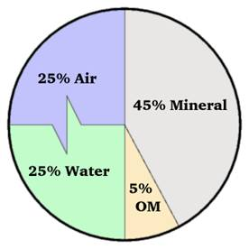
Components of Soil
The basic components of soil are minerals, organic matter, water and air. The typical soil consists of approximately
45% mineral,
5% organic matter,
20-30% water, and
20-30% air.
soil minerals and organic matter hold and store nutrients,
soil water is what readily provides nutrients for plant uptake.
Soil air, supports microorganisms that live in the soil need air to undergo the biological processes that release additional nutrients into the soil.

Slide 4
Soil Minerals
Soil minerals play a vital role in soil fertility and these minerals vary greatly in size and chemical composition.
FINE EARTH FRACTION
The fine earth fraction includes any particle less than 2.0 mm (.078 inches) and is divided into three classes of size: sand, silt, or clay.
COARSE FRACTION
The coarse fraction of soil includes any soil particles greater than 2mm. The coarse fraction includes boulders, stones, gravels, and coarse sands. These are rocky fragments and are generally a combination of more than one type of mineral.

Slide 5
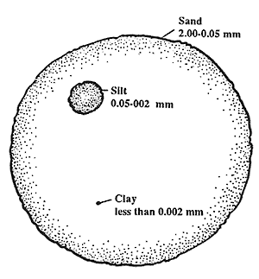
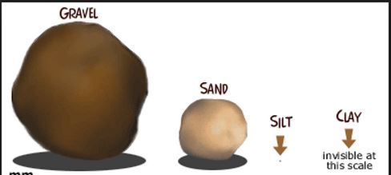
Description of sand, silt, and clay classes.
The Fine Earth Fraction
 | Size | Texture | Characteristics
Sand | 2.0 mm -0.05 mm | gritty | Sand is visible to eyes normally, consists of particles with low surface area, and permits excessive drainage.
Silt | 0.05 mm - 0.002 mm | buttery | Silt is not visible to eyes normally and increases the water holding capacity of soil.
Clay | < 0.002 mm | sticky | Clay has a high surface area, high water holding capacity, many small pores, and possesses charged surfaces to attract and hold nutrients.

Slide 6
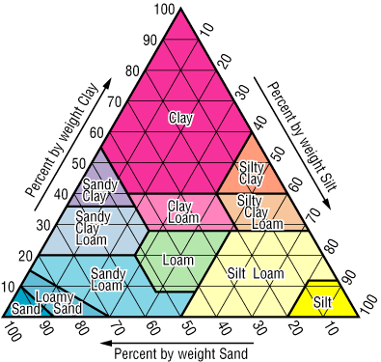
Texture
Soil texture refers to the weight proportion (relative proportion by weight percentage of sand, silt, and clay) of the mineral soil separates for particles less than two millimeters (mm) as determined from a laboratory particle-size distribution.
Soil texture is an important soil characteristic that influences storm water infiltration rates.
Textural Triangle.
The soil textural class is a grouping of soils based upon these relative proportions. Soils with the finest texture are called clay soils, while soils with the coarsest texture are called sands.

Slide 7
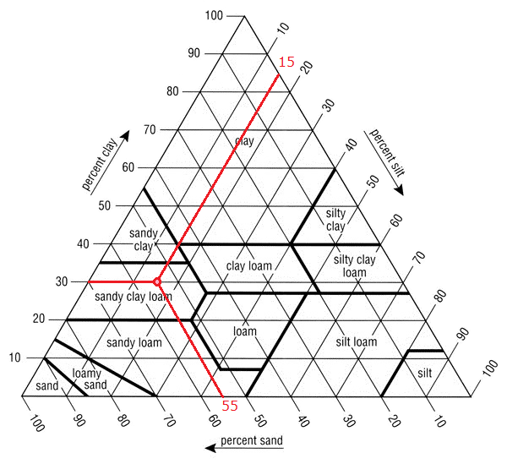
Example: Classify a soil sample that is 30% clay, 15% silt, and 55% sand.
First locate 30% on the clay axis, and draw a line horizontally from left to right. Next, locate 15% on the silt axis, and draw a line going down diagonally to the left. Finally, locate 55% on the sand axis, and draw a line going up diagonally to the left. The intersection is in a region called Sandy Clay Loam.

Slide 8
Soil Minerals and Mineral Composition
Typical soil parent mineral materials are:
Quartz: SiO_{2,}
Calcite: CaCO_{3,}
Feldspar: KAlSi₃O_{8,}
Mica (biotite): K(Mg,Fe)₃AlSi₃O₁₀(OH)₂

Slide 9
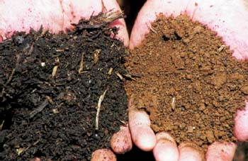
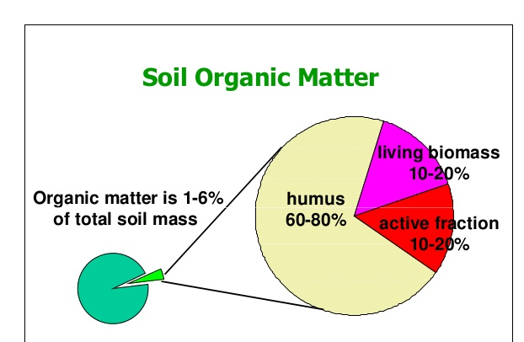
Soil Organic Matter
Soil organic matter includes all organic (or carbon-containing) substances within the soil.
Soil organic matter includes:
Living organisms (soil biomass)
The remains of microorganisms that once inhabited the soil
The remains of plants and animals
Organic compounds that have been decomposed within the soil and, over thousands of years, reduced to complex and relatively stable substances commonly called humus.

Slide 10
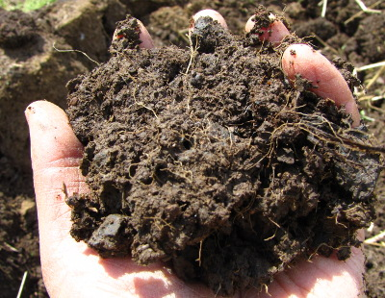
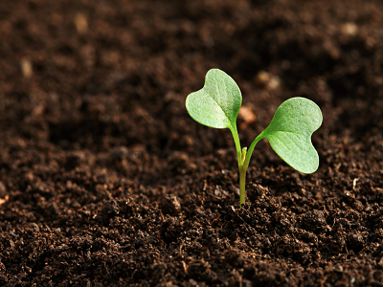
Important Functions of Organic Matter
Acts as a binding agent for mineral particles.
This is responsible for producing friable (easily crumbled) surface soils.
Increases the amount of water that a soil may hold.
Provides food for organisms that inhabit the soil.
Humus is an integral component of organic matter because it is fairly stable and resistant to further decomposition.

Slide 11
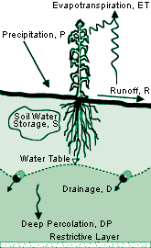
Soil water and its importance
The presence of water is essential for plants and organisms in the soil.
Water is necessary for the weathering of soil.
Soil water is the medium from which all plant nutrients are assimilated by plants. Soil water contains dissolved organic and inorganic substances and transports dissolved nutrients, such as nitrogen, phosphorus, potassium, and calcium, to the plant roots for absorption.

Slide 12
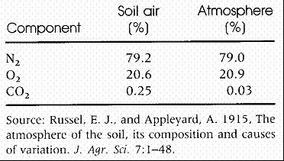
Soil Air
Soil aeration influences the availability of many nutrients.
Since plant roots require water and oxygen
Some environmental contaminants below ground produce gas which diffuses through the soil such as from landfill wastes, mining activities, and contamination by petroleum hydrocarbons which produce volatile organic compounds.

Slide 13
Soil Micro and macronutrients
Element | Symbol | mg/kg | percent
Nitrogen | N | 15,000 | 1.5
Potassium | K | 10,000 | 1.0
Calcium | Ca | 5,000 | 0.5
Magnesium | Mg | 2,000 | 0.2
Phosphorus | P | 2,000 | 0.2
Sulfur | S | 1,000 | 0.1
Chlorine | Cl | 100 | --
Iron | Fe | 100 | --
Boron | B | 20 | --
Manganese | Mn | 50 | --
Zinc | Zn | 20 | --
Copper | Cu | 6 | --
Molybdenum | Mo | 0.1 | --
Nickel | Ni | 0.1 | --
Macronutrients: N, K, Ca, Mg, P, and S, and Micronutrients: Cl, Fe, B, Mn, Zn, Cu, Mo, and Ni

